Slide 1
Welcome to our Group Presentation
Submitted By:
Team 14
Bushra Yesmeen Anika(19101350)
Rafid Rahman(22341039)

Slide 2
Content Analysis Using Keyword Extraction

Slide 3
What is content analysis?
Definition: Content analysis is a research tool used to determine the presence of certain words, themes, or concepts within some given qualitative data.
Examples: Finding correlations, Identifying propaganda, Revealing differences etc.

Slide 4
Keyword Extraction
Definition: Keyword extraction is an automated method of extracting the most relevant words and phrases from text input.

Slide 5
How Keyword Extraction Works

Slide 6
Steps of Keyword Extraction
Preprocessing
Tokenization
Word frequency calculation
Ranking
Weighting
Final Extracted Keywords

Slide 7
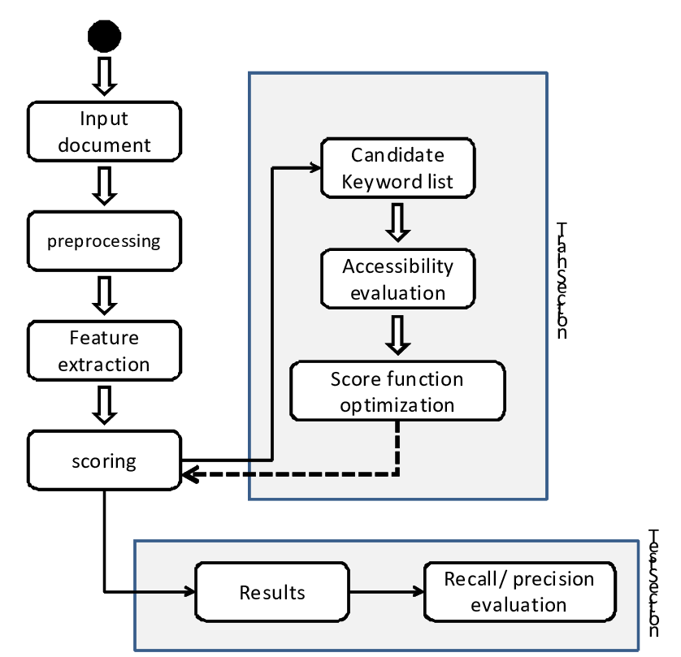
Steps Representation in Flowchart

Slide 8
Applications of Keyword Extraction
Examples:
Search engine optimization
Content analysis
Text classification
Information retrieval
Sentiment analysis

Slide 9
Conclusion

